Slide 1
Lamoille Housing Study &
Needs Assessment
January 29, 2019

Slide 2
Study Process
Collect & Interpret Data
Assess Market & Trends
Analyze – Make Findings
The ‘Study Area’ – 10 Lamoille Cty. Towns + Hardwick
Town x Town/Regional Data - Variation
Analyze – Make Findings

Slide 3
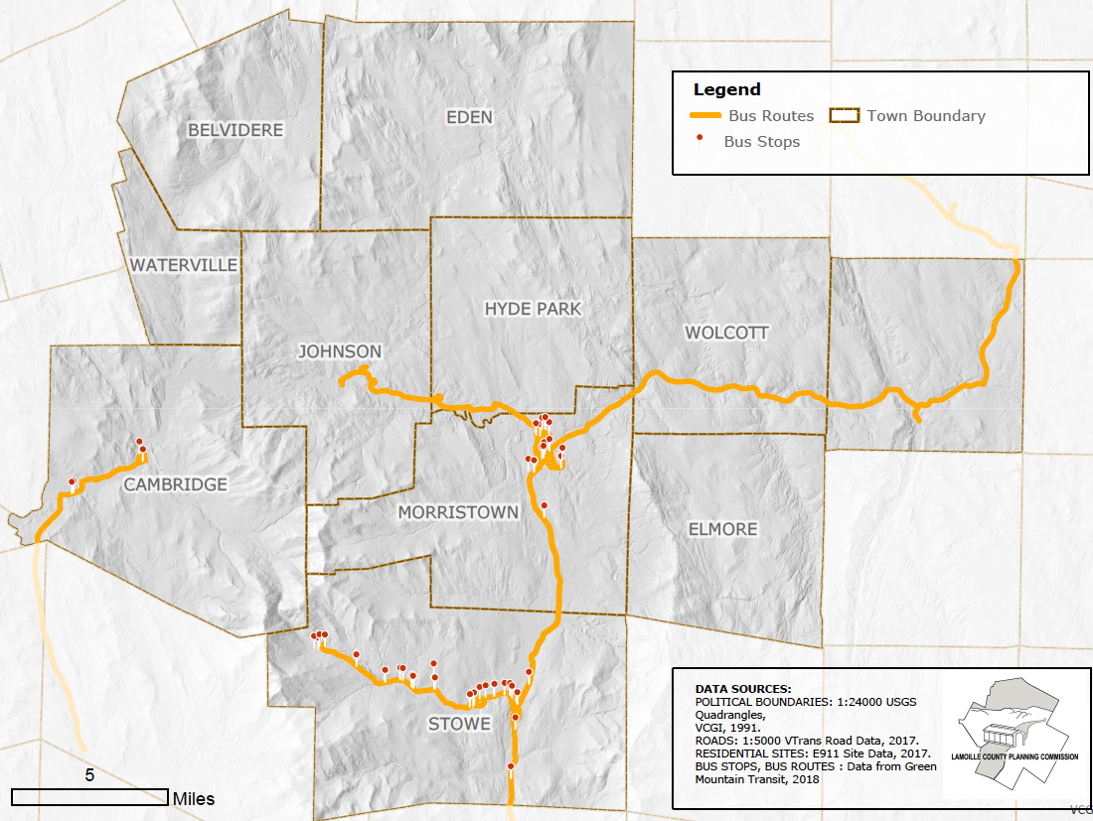
Study Area

Slide 4
Issues for Consideration
Growth – Encourage? Discourage?
Attracting New Households
Focus on Downtowns/Villages
The Power of the Market
Policy – Town x Town or Regional?
Other
Politics
Money
Working Outside the Market

Slide 5
Economy
Labor Force and Employment Growth runs counter to Vermont trend.

Slide 6
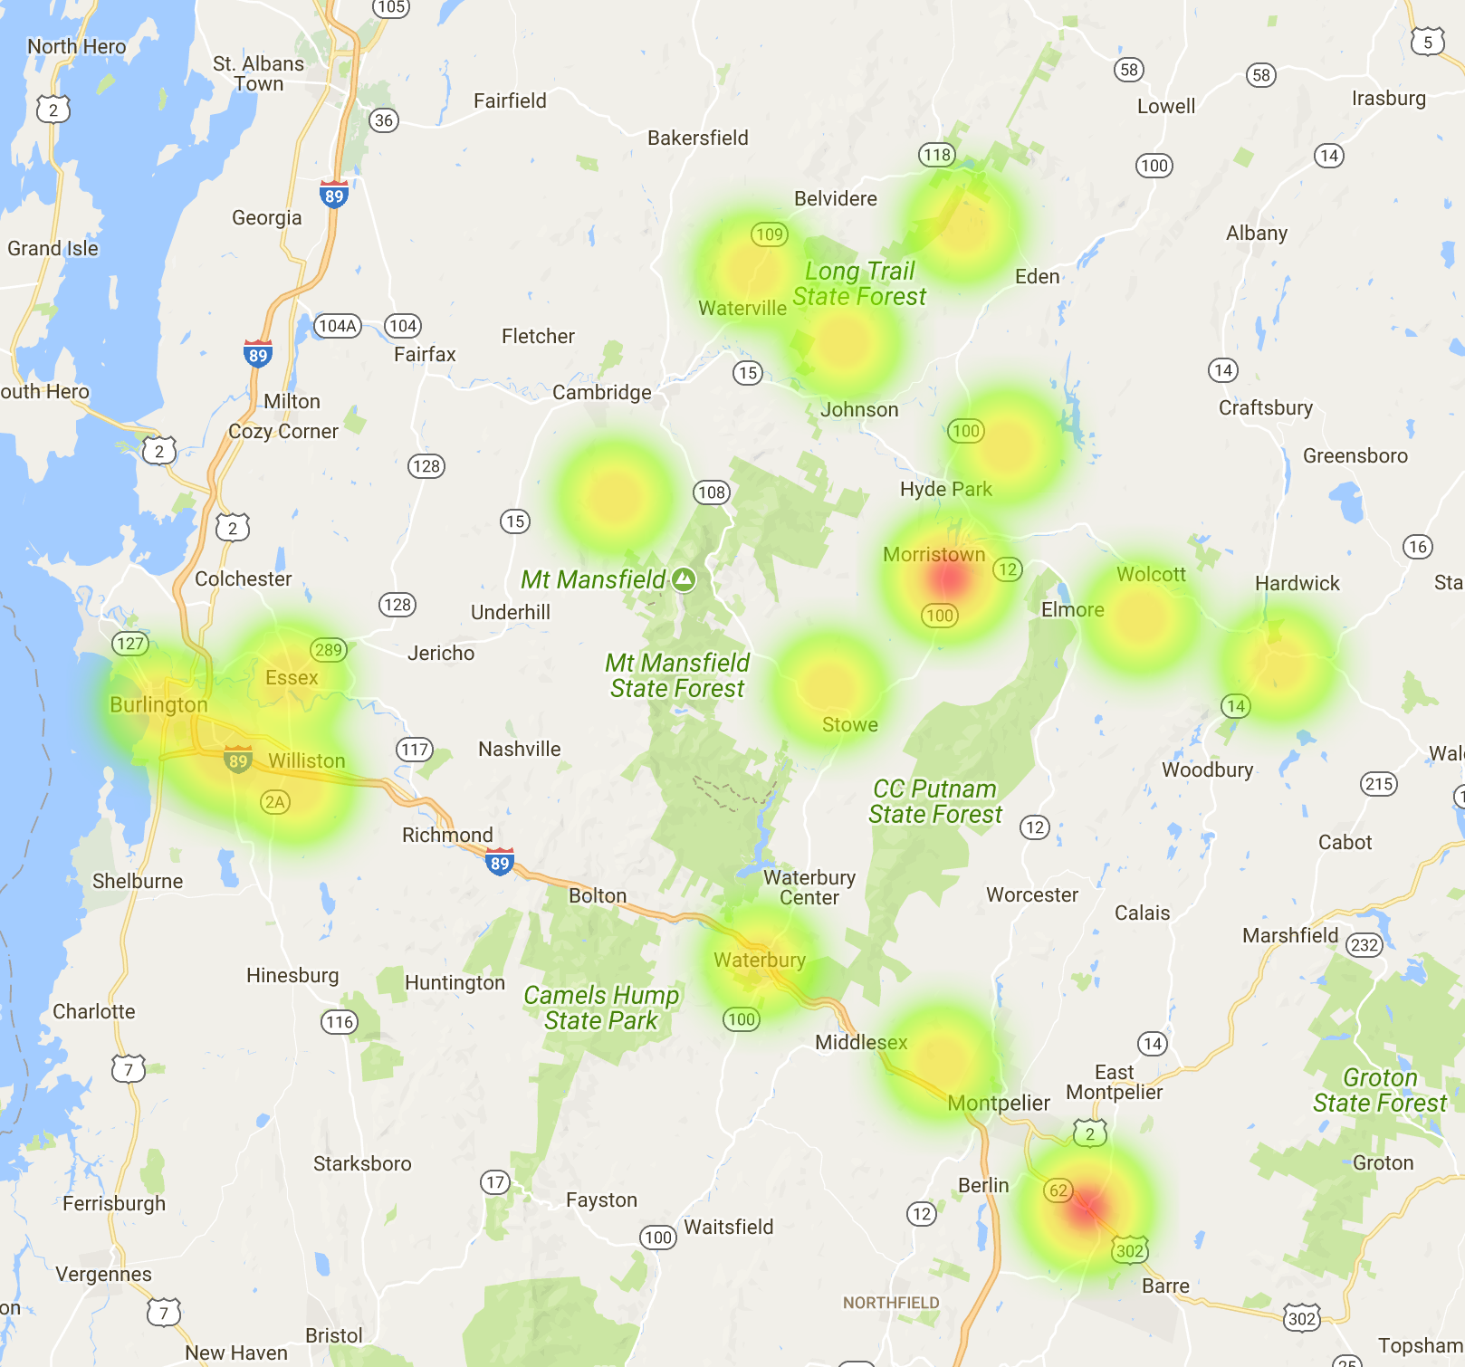
Where They Work
24% Live & Work in Same Town
85% of Study Area Workers Live in the Study Area

Slide 7
Housing Stock

Slide 8
Housing – Quick Facts
54% of all Units in Morristown, Stowe, Hardwick
Only 7% in Waterville, Belvidere, Elmore
29% of All Households are Renters
46% in Johnson; 12% in Wolcott
15% of All Housing Units are Seasonal
55% in Stowe; 1% in Hyde Park

Slide 9
Housing – New Development - 2010 - 2017
86% of New Permits in Stowe, Morristown and Hyde Park.

Slide 10
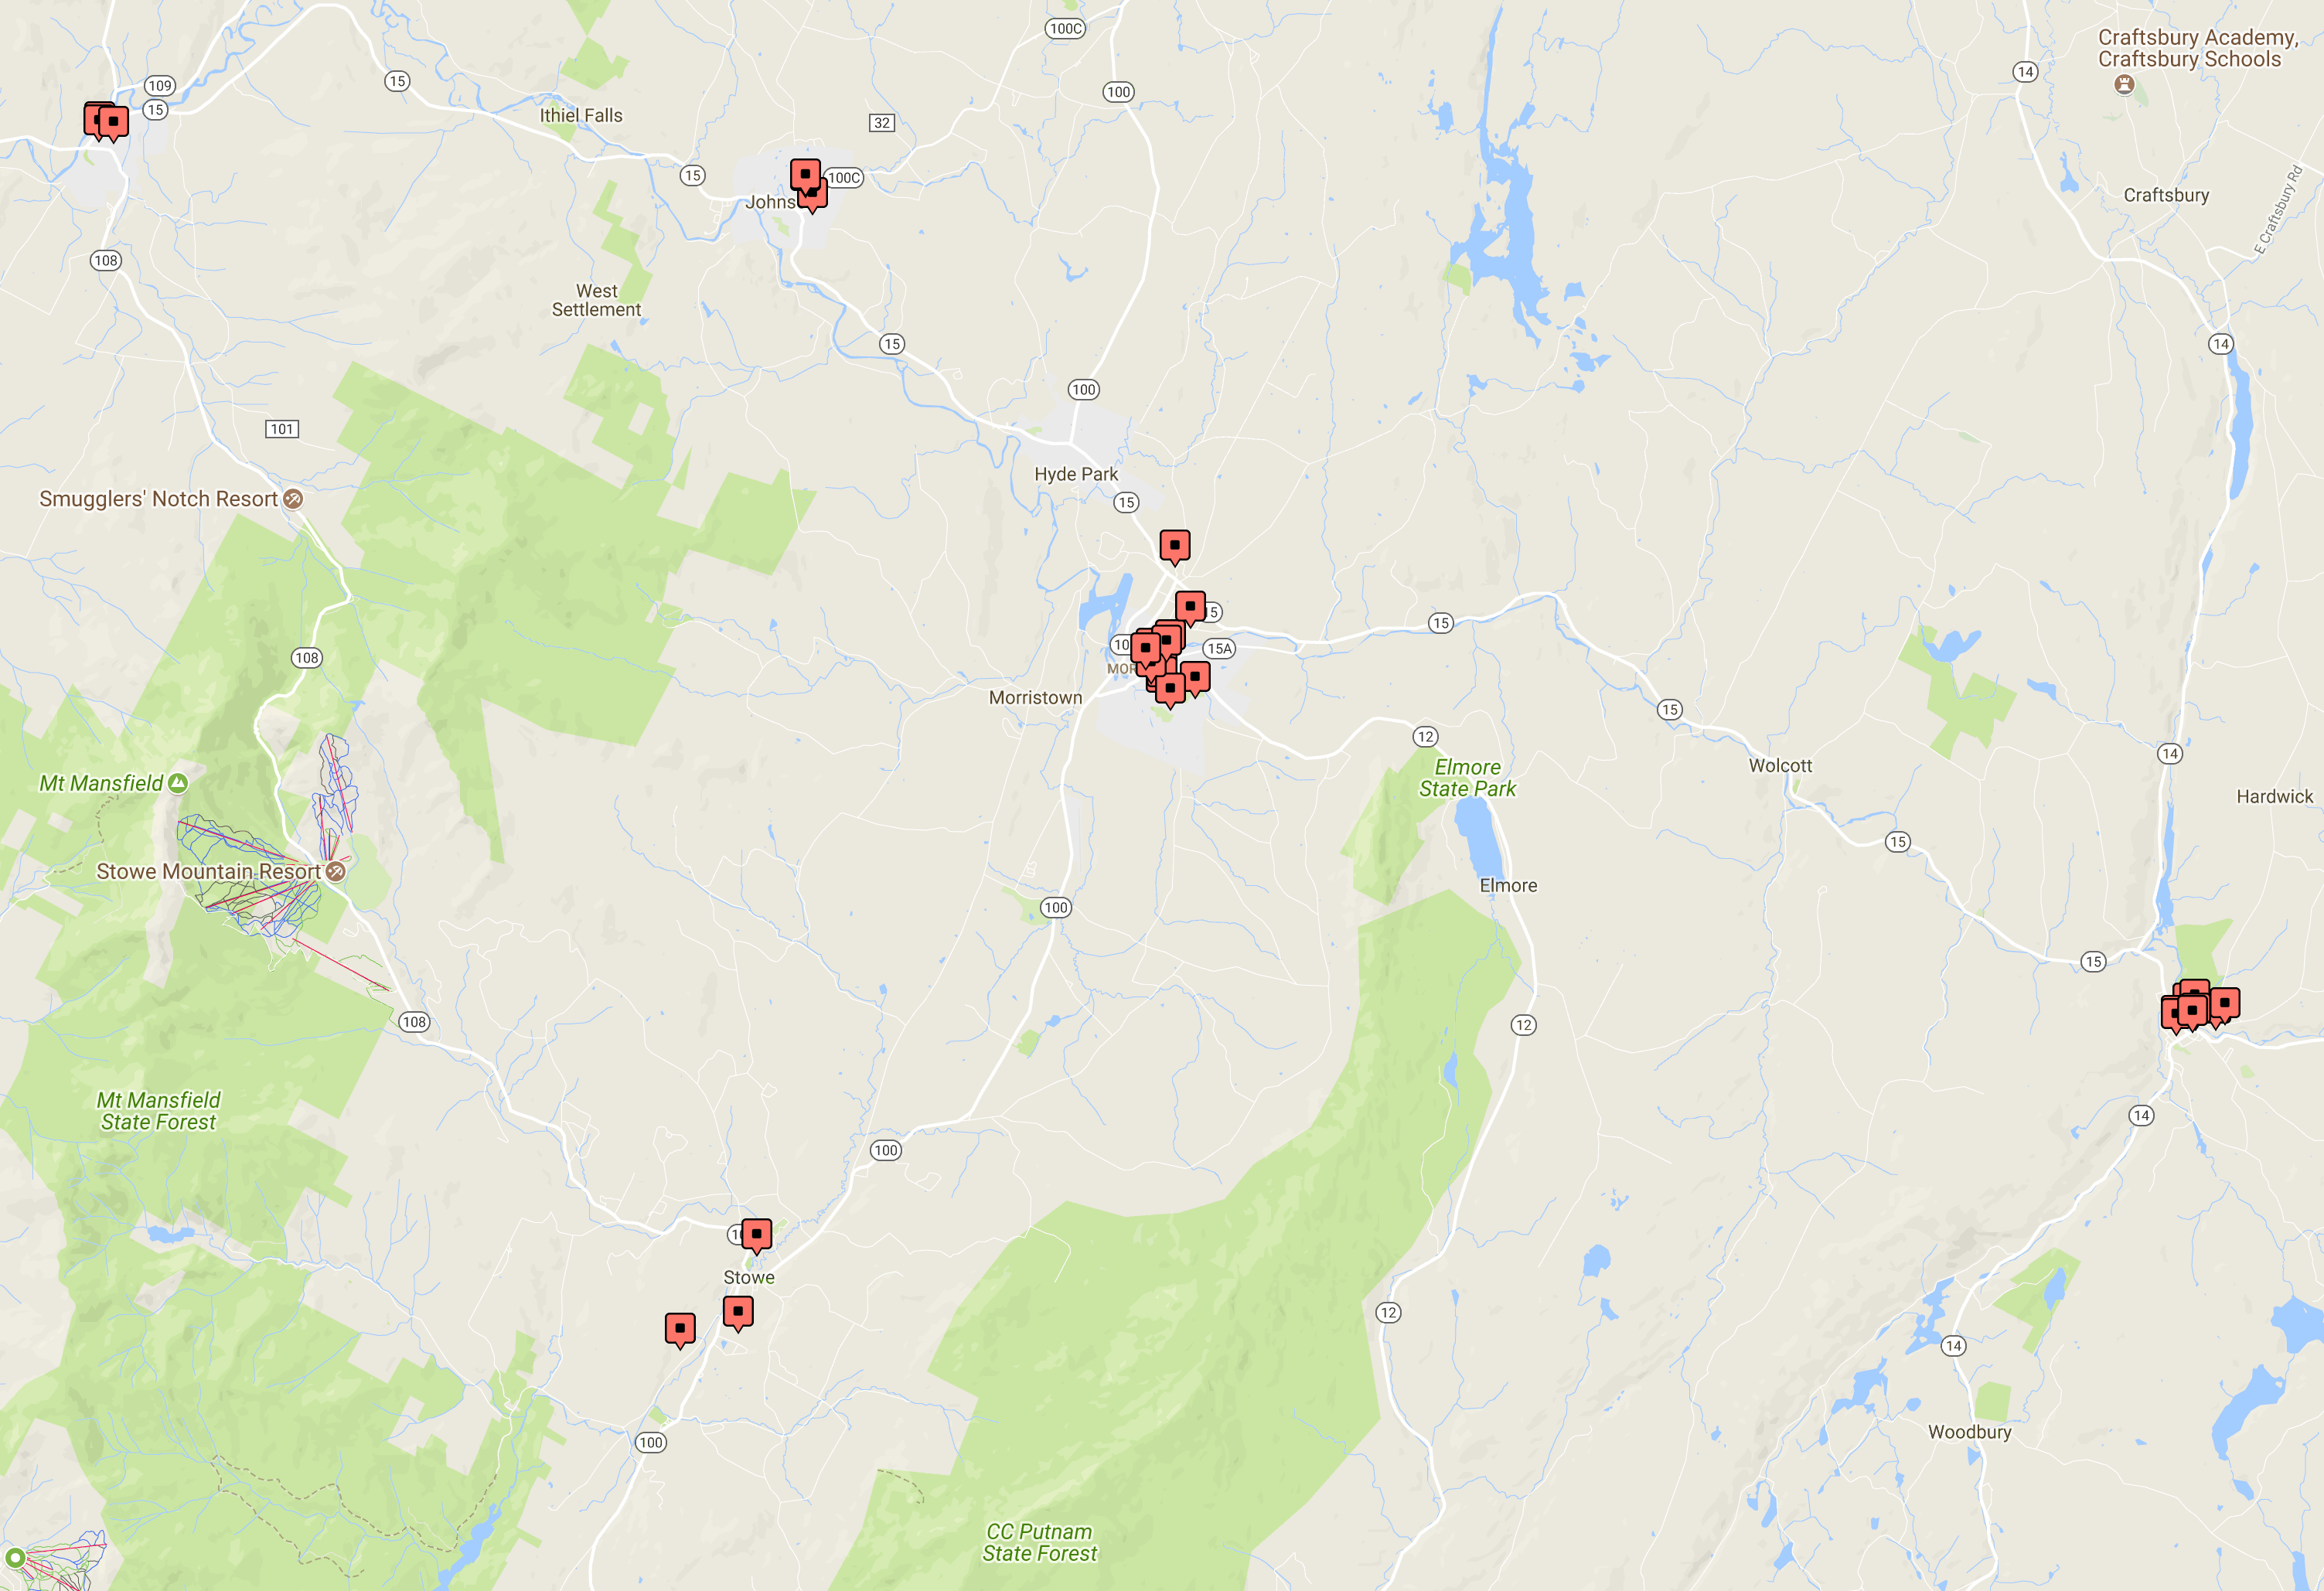
Subsidized/Affordable Housing – Where & What?
418 Units in 23 Projects
57% Deeply Subsidized
38% Tax Credit
57% for Elderly/Disabled
Occupancy Rate Typically in 98+ Percent Range – Most Projects Have Wait Lists

Slide 11
Housing Market

Slide 12
For-Sale Market - Trends
R1 Properties Only – Fair Market Sales

Slide 13
Median Sale Pricing – Town x Town
R1 Properties Only – Fair Market Sales

Slide 14
Median For-Sale Listing– Town x Town
Condominiums not included.

Slide 15
Rental Market -
A Closer Look

Slide 16
Rental Vacancy – Big Picture
Lamoille Cty. Vacancy Rate (2017) – 3.2%

Slide 17
Median Gross Rent – Town x Town

Slide 18
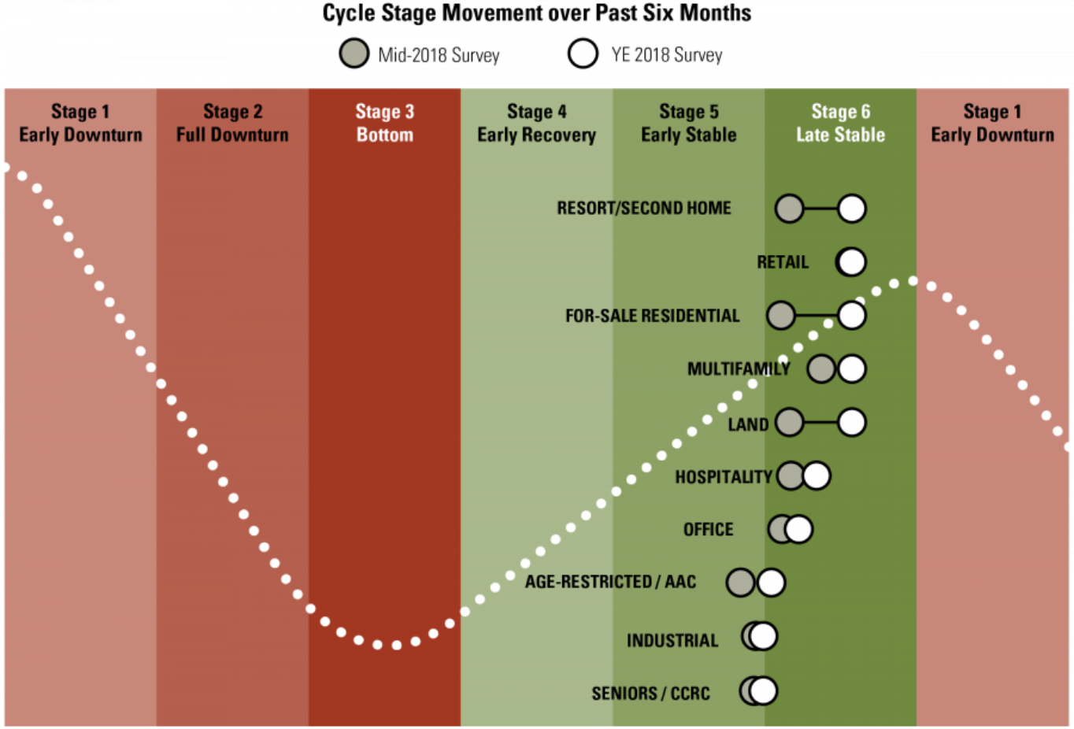
Residential Real Estate – Market Cycle

Slide 19
The People -
Demographics & Income

Slide 20
Demographics– Quick Facts
10.3% Household Increase 2000 - 2016
Vermont 6.8% Increase during same period.
Cambridge & Morristown - 53% of Increase
Projected Household Growth 2017 – 2022
+600 New Households (5.2%)
Mobility – 14% of HHs Moved in Past Year
5% in Belvidere; 23% in Johnson

Slide 21
Aging – A Major Factor
Households 65+ will increase by 19.4%

Slide 22
Household Size – Small Rules

Slide 23
Renter vs. Owner HH Incomes
Overall Median HH - $52,642

Slide 24
Poverty Rate

Slide 25
Renters – Segment with Incomes <$25,000

Slide 26
Renters - Rent Exceeds 35% of HH Income

Slide 27
So What?

Slide 28
Out of Balance? – Households & Housing Stock

Slide 29
HH Income and Housing Cost – Varying Trends

Slide 30
The Communities & Employers
Morristown
Infrastructure Capacity – Developable Land Available
Shortage of Market Rate Rentals – ‘Numbers Support Development’
Stowe
Infrastructure Capacity
Seasonal Housing/AirBnB - Factors in Market
‘Numbers’ Support Market Rate Development
Cambridge
Supply Housing for Elders
Impact of Chittenden Housing Market
Employers
Emphasis is Currently on Market Rate Rental Housing

Slide 31
Assessment &
Findings

Slide 32
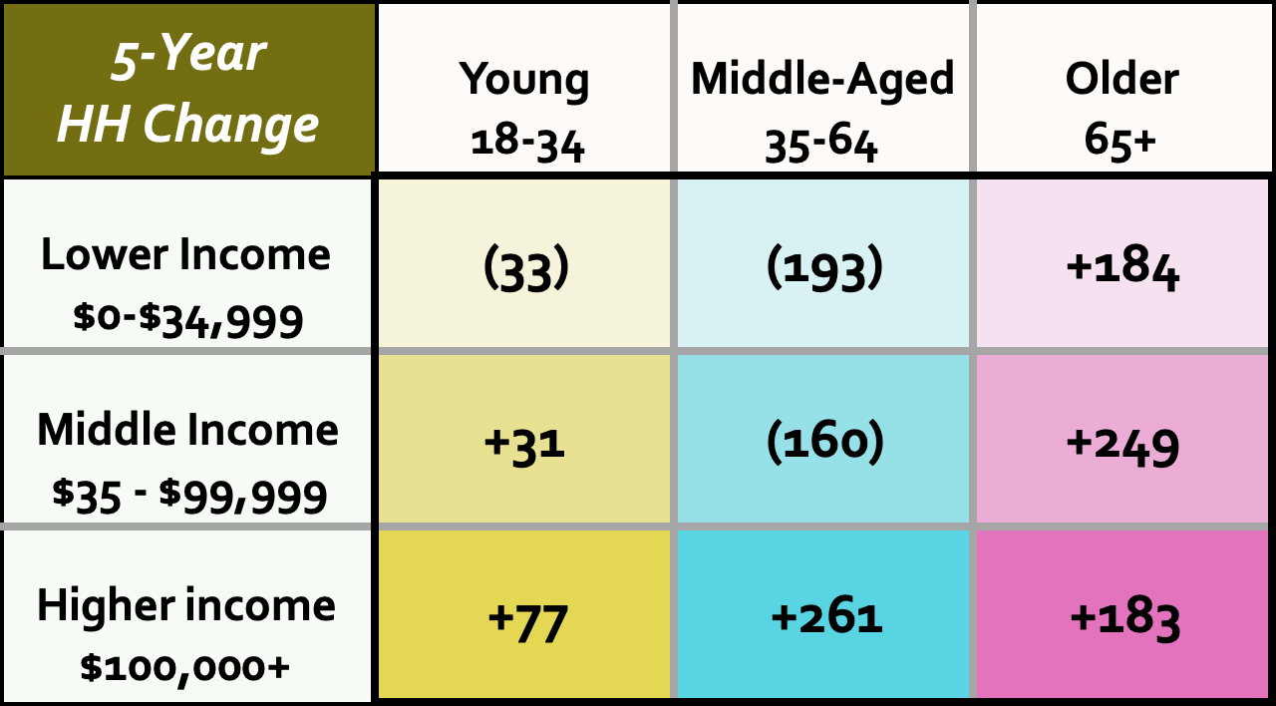
HH Age/Income – Five-Year Change

Slide 33
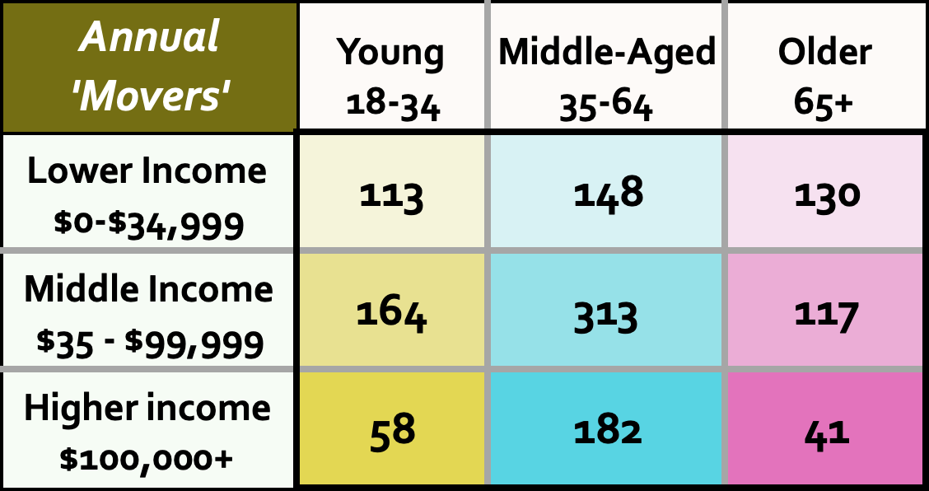
Annual ‘Movers’ by HH Age/Income Group

Slide 34
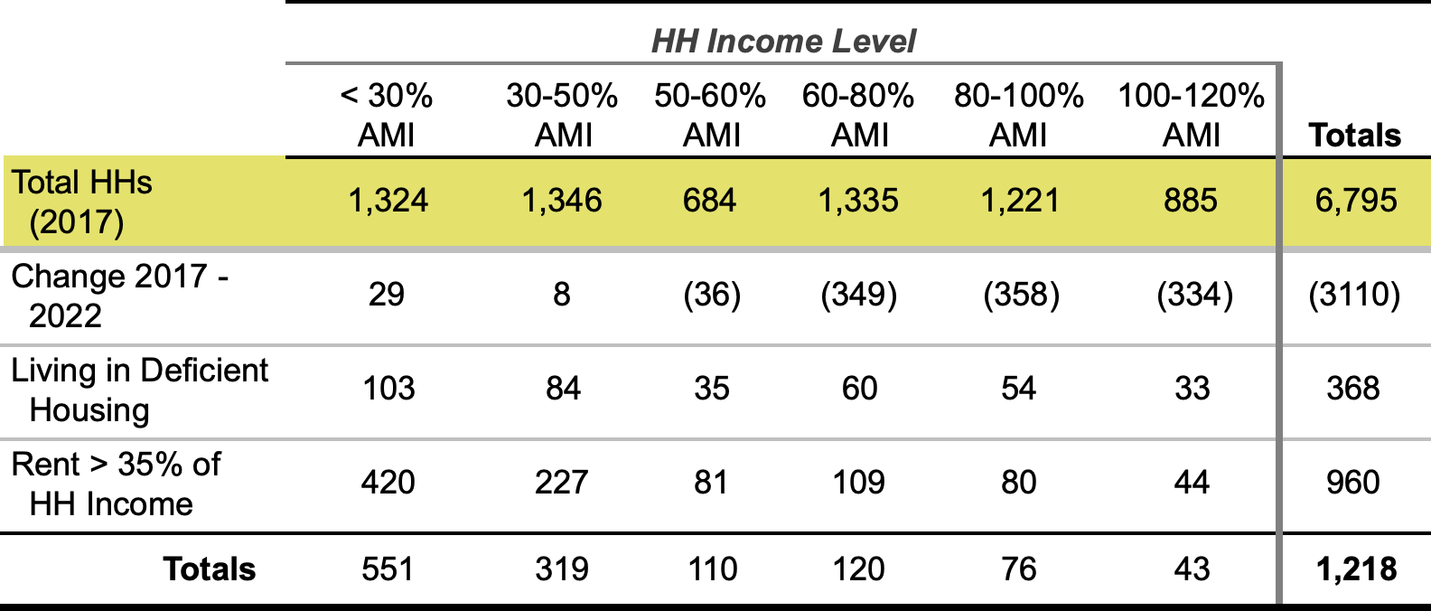
‘Need’ by Income Group
Home Ownership
Affordable for HH at 100-120% of AMI is $150,000 to $250,000
Current Listings – 65+/- in this Range – 25% are Condominiums

Slide 35
Stress Points
Low Income/Subsidy –
53 Subsidies for every 100 HHs of Extremely Low Income
Market Rentals
Low Vacancy Coupled with Insufficient Unit Production
Johnson
Poverty – HHs Paying High Percent of income Toward Rental
Cambridge –
Season Activity & Chittenden Cty. Market Stressing Pricing
Stowe
Pricing far out of Line with Income in Employment Center
Morristown
Lack of Market Rentals Slowing Economic Growth

Slide 36
Priorities
Senior Housing Options
Subsidies – Vermod/Modular – Co/Shared Housing – Services/Transportation
Market Rate Rentals
ID Sites – Regulatory/Density – Rehabilitation – Infrastructure
Subsidized Housing/Vouchers
Resources Primarily at Federal Level
Future – Ownership Options

